Slide 1

INTRODUCTION
Nitin Kushwaha
Course – Data Structure and Algorithm
Type- Summer Training

Slide 2
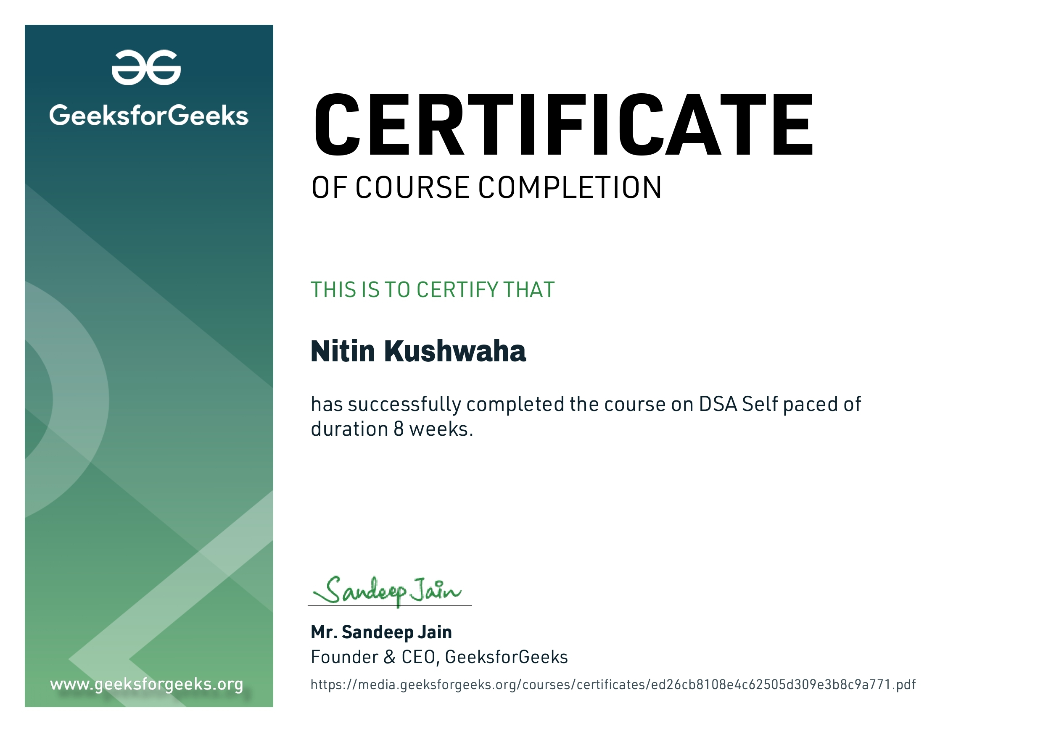
Certificate

Slide 3
COURSE CONTENT
Mathematics
Bit Magic
Recursion
Arrays
Searching
Sorting
Matrix
String
Linked List
Stack
Queue
Tree
Binary Search Tree
Heap
Graph
Backtracking
Dynamic Programming

Slide 4
INTRODUCTION
A data structure is a named location that can be used to store and organize large sets of data.
1.Data is stored efficiently on hard disk.
2.Data retrieval is easy.
And, an algorithm is a collection of steps to solve a particular problem.
1.Language independent, easy to understand and implement.
2.Saves time and unwanted processing
Example: - Searching a number in array of numbers.
1.Data structure used here to store numbers: - Array
2.Algorithms that can be used: - Binary search / linear search

Slide 5
BIT MAGIC
The Bitwise Algorithms is used to perform operations at the bit-level or to manipulate bits in different ways. The bitwise operations are found to be much faster and are sometimes used to improve the efficiency of a program.
For example: To check if a number is even or odd. This can be easily done by using Bitwise-AND(&) operator. If the last bit of the operator is set than it is ODD otherwise it is EVEN. Therefore, if num & 1 not equals to zero than num is ODD otherwise it is EVEN.

Slide 6
RECURSION
The process in which a function calls itself directly or indirectly is called recursion and the corresponding function is called a recursive function. Using a recursive algorithm, certain problems can be solved quite easily. Examples of such problems are Towers of Hanoi (TOH), Inorder/Preorder/Postorder Tree Traversals, DFS of Graph, etc. A recursive function solves a particular problem by calling a copy of itself and solving smaller subproblems of the original problems. Many more recursive calls can be generated as and when required. It is essential to know that we should provide a certain case in order to terminate this recursion process. So we can say that every time the function calls itself with a simpler version of the original problem.

Slide 7
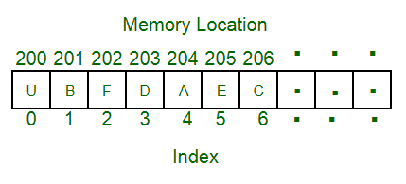
ARRAY
An array is a collection of items stored at contiguous memory locations. The idea is to store multiple items of the same type together. This makes it easier to calculate the position of each element by simply adding an offset to a base value, i.e., the memory location of the first element of the array (generally denoted by the name of the array).

Slide 8
SEARCHING
Searching Algorithms are designed to check for an element or retrieve an element from any data structure where it is stored. Based on the type of search operation, these algorithms are generally classified into two categories:
Sequential Search: In this, the list or array is traversed sequentially and every element is checked. For example: Linear Search.
Interval Search: These algorithms are specifically designed for searching in sorted data-structures. These type of searching algorithms are much more efficient than Linear Search as they repeatedly target the center of the search structure and divide the search space in half. For Example: Binary Search.

Slide 9
SORTING
A Sorting Algorithm is used to rearrange a given array or list of elements according to a comparison operator on the elements. The comparison operator is used to decide the new order of elements in the respective data structure.
For Example: The below list of characters is sorted in increasing order of their ASCII values. That is, the character with a lesser ASCII value will be placed first than the character with a higher ASCII value.

Slide 10
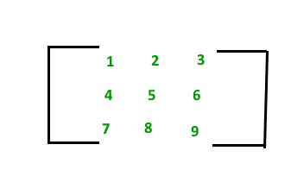
MATRIX
A matrix represents a collection of numbers arranged in an order of rows and columns. It is necessary to enclose the elements of a matrix in parentheses or brackets
For example:
This Matrix [M] has 3 rows and 3 columns. Each element of matrix [M] can be referred to by its row and column number. For example, a23 = 6.

Slide 11
STRING
Strings are defined as an array of characters. The difference between a character array and a string is the string is terminated with a special character ‘\0’.
Below are some examples:
“geeks”, “for”, “geeks”, “GeeksforGeeks”, “Geeks for Geeks”, “123Geeks”, “@123 Geeks”

Slide 12
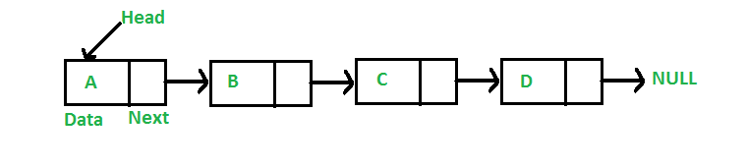
LINKED LIST
A linked list is a linear data structure, in which the elements are not stored at contiguous memory locations. The elements in a linked list are linked using pointers

Slide 13
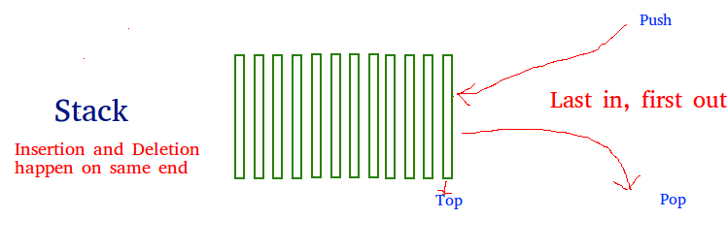
STACK
Stack is a linear data structure which follows a particular order in which the operations are performed. The order may be LIFO(Last In First Out) or FILO(First In Last Out).

Slide 14
QUEUE
A queue is defined as a linear data structure that is open at both ends and the operations are performed in First In First Out (FIFO) order.
We define a queue to be a list in which all additions to the list are made at one end, and all deletions from the list are made at the other end. The element which is first pushed into the order, the operation is first performed on that.

Slide 15
TREE
A tree is non-linear and a hierarchical data structure consisting of a collection of nodes such that each node of the tree stores a value and a list of references to other nodes (the “children”).
This data structure is a specialized method to organize and store data in the computer to be used more effectively. It consists of a central node, structural nodes, and sub-nodes, which are connected via edges. We can also say that tree data structure has roots, branches, and leaves connected with one another.

Slide 16
BINARY SEARCH TREE
Binary Search Tree is a node-based binary tree data structure which has the following properties:
The left subtree of a node contains only nodes with keys lesser than the node’s key.
The right subtree of a node contains only nodes with keys greater than the node’s key.
The left and right subtree each must also be a binary search tree.

Slide 17
HEAP
A Heap is a special Tree-based data structure in which the tree is a complete binary tree.
Operations of Heap Data Structure:
Heapify: a process of creating a heap from an array.
Insertion: process to insert an element in existing heap time complexity O(log N).
Deletion: deleting the top element of the heap or the highest priority element, and then organizing the heap and returning the element with time complexity O(log N).
Peek: to check or find the most prior element in the heap, (max or min element for max and min heap).

Slide 18
GRAPH
A Graph is a non-linear data structure consisting of vertices and edges. The vertices are sometimes also referred to as nodes and the edges are lines or arcs that connect any two nodes in the graph. More formally a Graph is composed of a set of vertices( V ) and a set of edges( E ). The graph is denoted by G(E, V).

Slide 19
BACKTRACKING
Backtracking is an algorithmic technique for solving problems recursively by trying to build a solution incrementally, one piece at a time, removing those solutions that fail to satisfy the constraints of the problem at any point of time (by time, here, is referred to the time elapsed till reaching any level of the search tree).

Slide 20
DYNAMIC PROGRAMMING
Dynamic Programming is mainly an optimization over plain recursion. Wherever we see a recursive solution that has repeated calls for same inputs, we can optimize it using Dynamic Programming. The idea is to simply store the results of subproblems, so that we do not have to re-compute them when needed later. This simple optimization reduces time complexities from exponential to polynomial.
For example, if we write simple recursive solution for Fibonacci Numbers, we get exponential time complexity and if we optimize it by storing solutions of subproblems, time complexity reduces to linear.

Slide 21
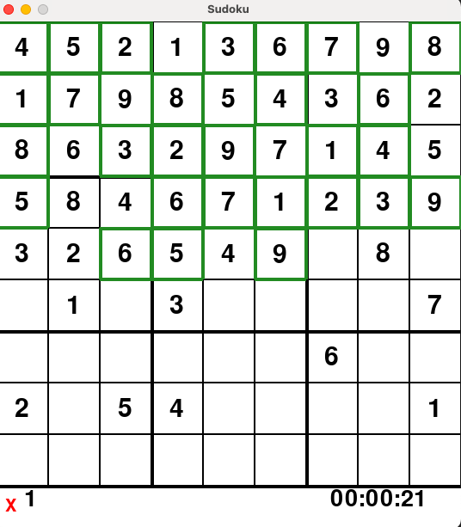
PROJECT

Slide 22


